Slide 1
Predicting Quality of Hospitals in the United States
Senait Abate

Slide 2
Can a hospital’s performance be predicted based on cost of care and qualitative ratings compared to the national average?

Slide 3
Main Data Features
3,715 hospitals
Rating: 1-5
Hospital ratings compared to the national average
1 =lowest, 2 =below average, 3 =average, 4 =above average, 5 =highest
Hospital/Facility Type
Private, Government, Proprietary, Church, Unknown
Average Cost of Care
Heart attack, heart failure, pneumonia, and hip and knee procedures
Cost of Care Rating
Value and quality for each procedure rated from 1 to 5

Slide 4
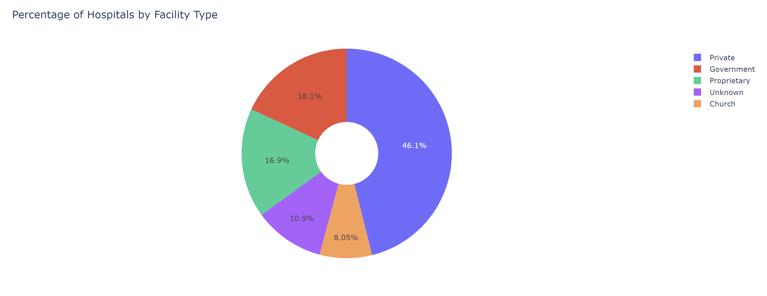
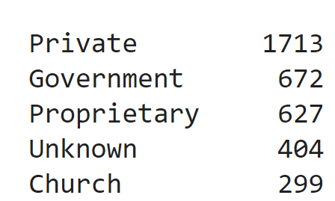
Percentage of Hospitals by Facility Type

Slide 5
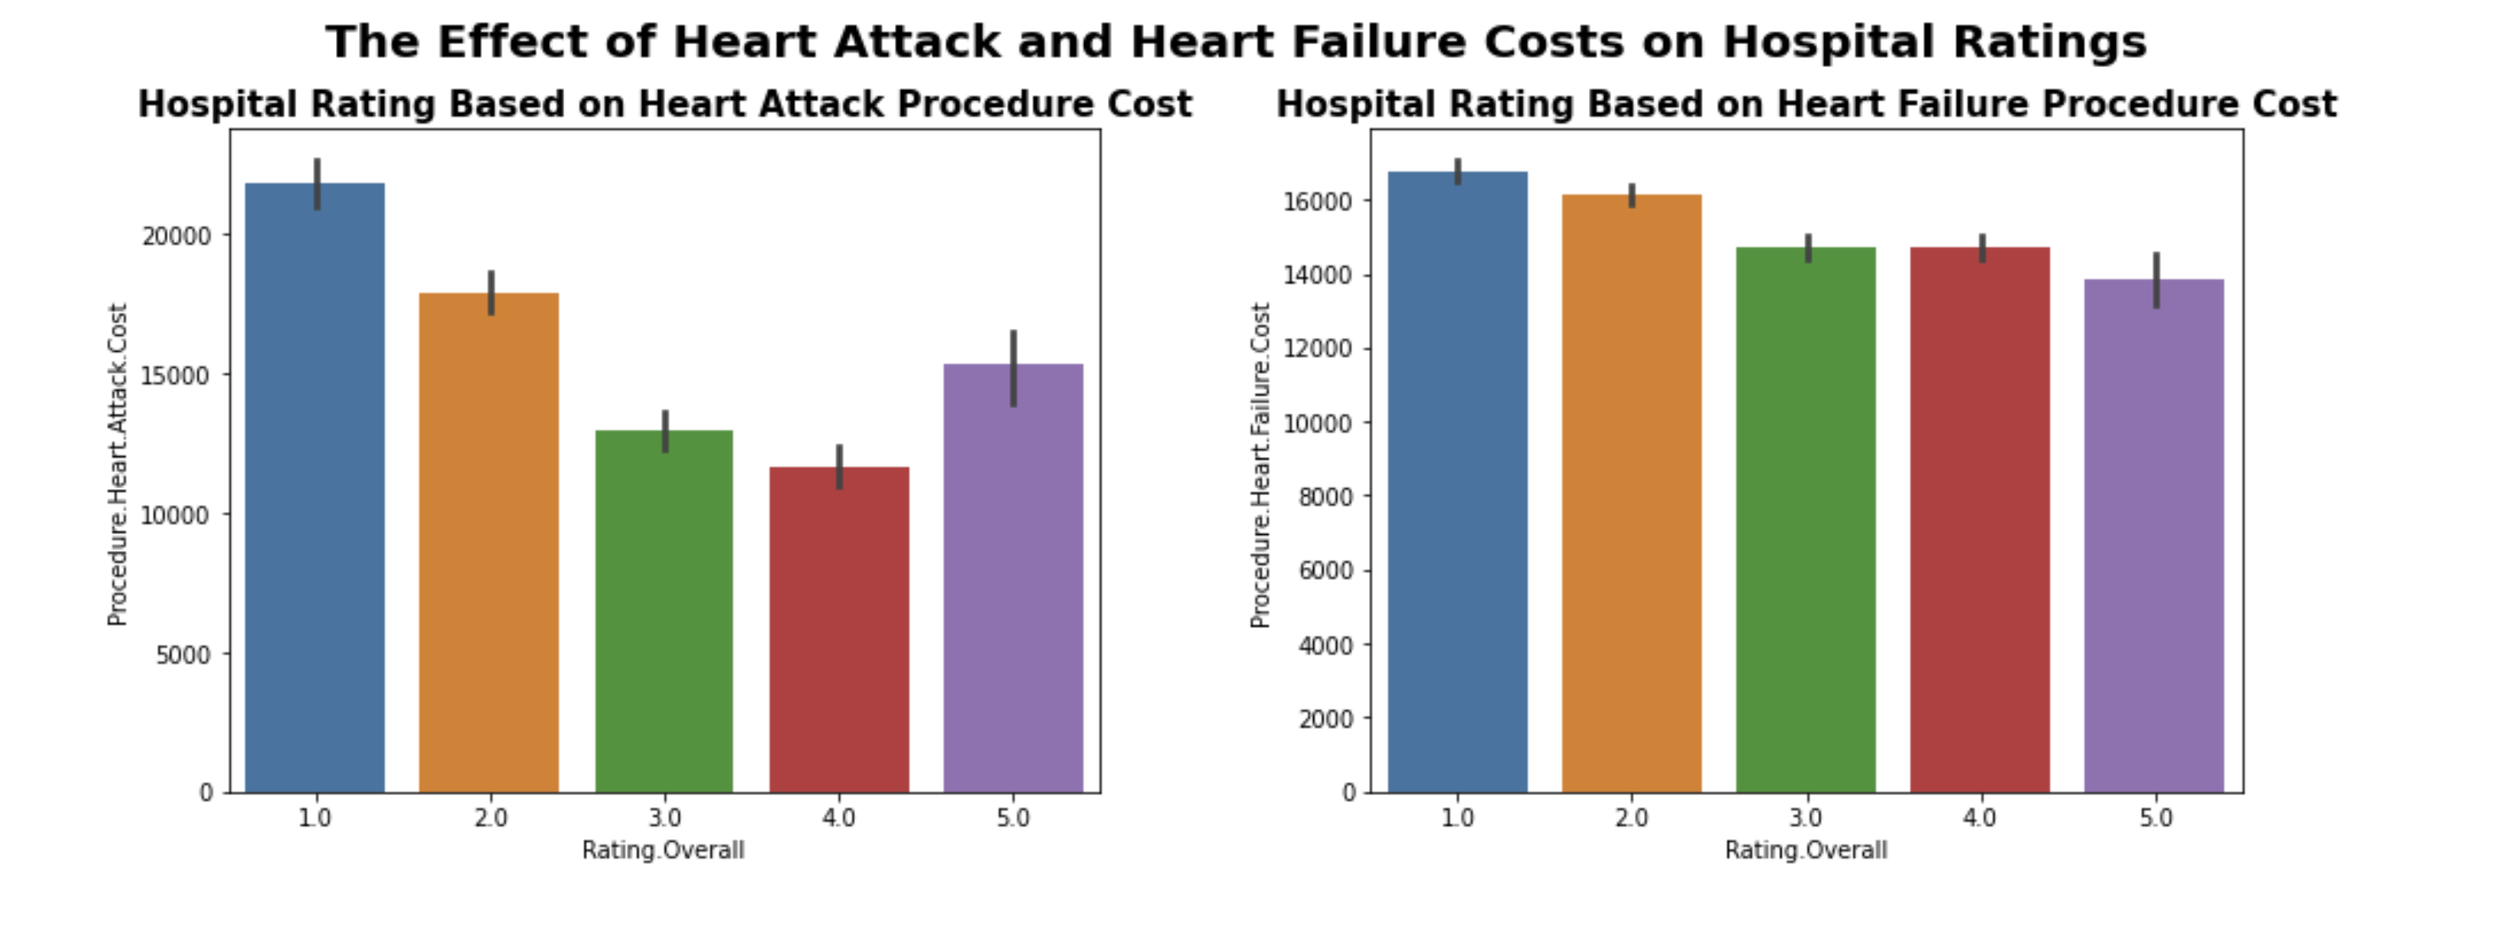
Heart Attack and Heart Failure Costs by Rating

Slide 6
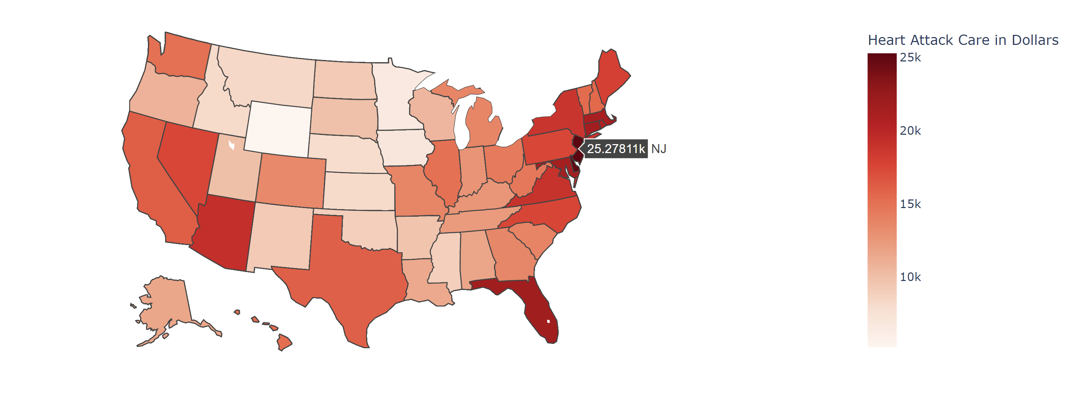
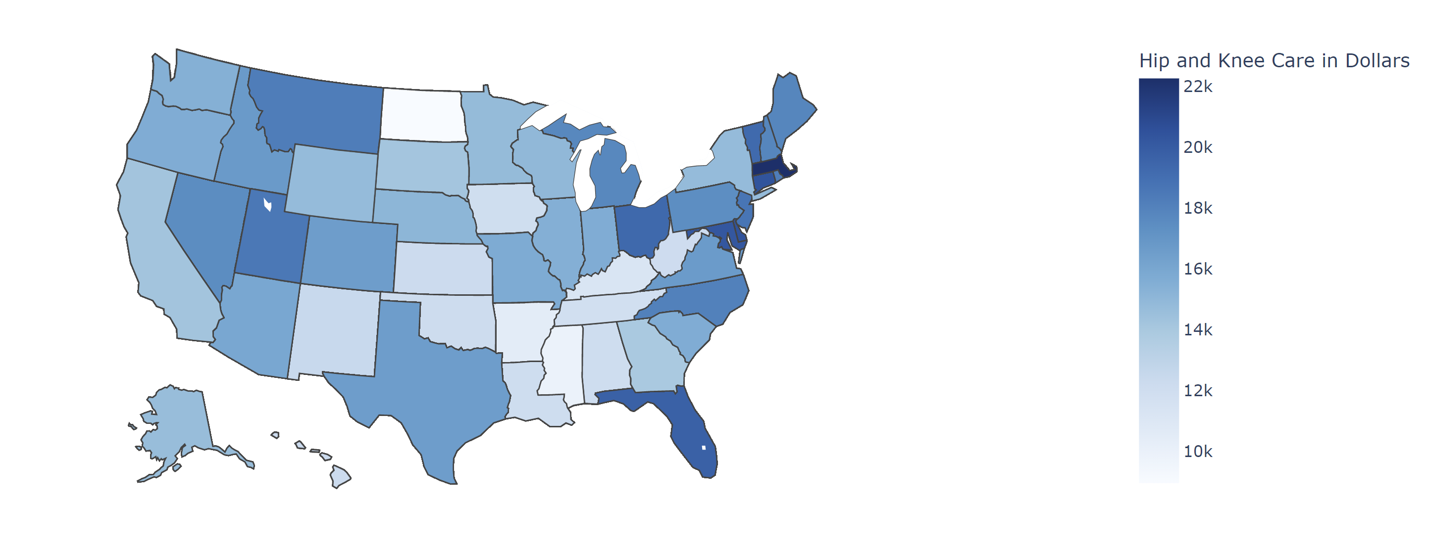
Average Cost of Heart Attack Care by State
Average Cost of Hip and Knee Care by State

Slide 7
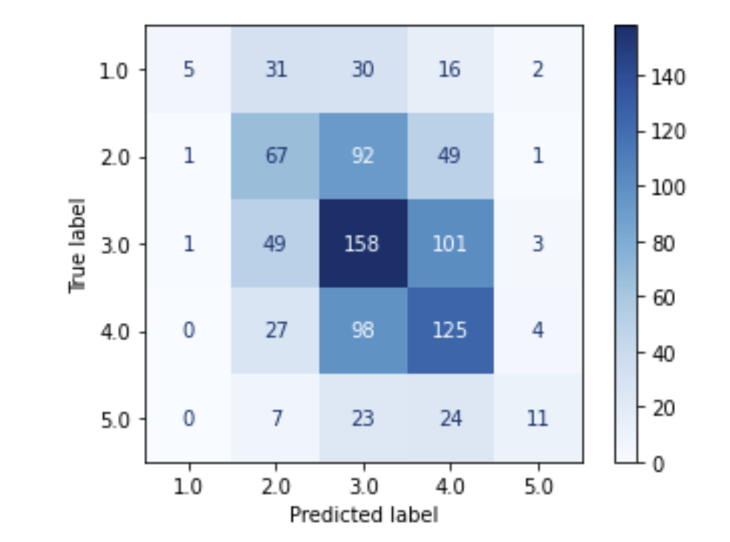
Model Evaluation
KNN model clusters data based on similar observations.
Prediction is based on the distance of a data point with other similar data points
KNN Model with best k
Improved to 42% test accuracy
Correlation matrix shows model can predict 3 and 4 rated hospitals well.
Predicting target with KNN
model with k value 36

Slide 8
Limitations and Recommendations
Over 6,000 hospitals nationally.
Data contains 3,715 hospitals
Other features not considered in the dataset may have a stronger correlation to a hospital's rating.
Data collected can be used for qualitative visual comparisons.
Model works well for predicting 3 and 4 rated hospitals.

